Slide 1

DEPARTMENT OF COMPUTER ENGINEERING
CCL MINI PROJECT
TOPIC : CANTEEN FOOD ORDERING SYSTEM
Made By:
Student Name: Himali Suroshi Roll No: 51 Division:C
Student Name: Megha Soni Roll No: 48 Division:C
Student Name: Pragya Tripathi Roll No: 55 Division:C
Under the guidance of : Prof. Deepali Kayande

Slide 2
Abstract:
Large educational institutes face lunchtime crowd issues in their canteens.
The cloud-based canteen food ordering project aims to provide a seamless and efficient food ordering experience for students and staff.
The cloud-based infrastructure enables scalability, flexibility, and reliability to handle a large number of orders.
The application allows customers to browse through the menu, select items, and make online payments.
The canteen manager has admin access to manage the menu, approve or reject orders. Real-time updates are provided on the status of orders, enabling customers to track their orders and estimate waiting times.
Notifications are sent to customers when their orders are ready for pickup, ensuring timely delivery of food.
The project aims to streamline the food ordering experience for customers and improve canteen operations' efficiency.

Slide 3
Problem Statement
Manual canteen system fails to meet management efficiency and customer satisfaction needs.
Heavy rush during breaks leaves little time for students and staff to eat.
Canteen managers struggle to manage orders and payments during peak hours.
Web-based canteen food ordering system improves efficiency and customer satisfaction.
The web-based system faces challenges in handling a large volume of traffic during peak hours.
Lack of flexibility in scaling the system leads to website crashes and user frustration.
Upgrading hardware can be time-consuming and expensive for the canteen manager

Slide 4
Objective
The objective of this project is to use the advantage of cloud services to run and manage this web application efficiently and smoothly.
Canteen Ordering System is to facilitate high-speed services to their students, staff members, etc.
It will be essential in facilitating lunch breaks for customers and the canteen.
This project will avail them of the benefits of digitization.
The goal of cloud computing is to provide easy, scalable access to computing resources and IT services.
Cloud infrastructure involves the hardware and software components required for the proper implementation of a cloud computing model.

Slide 5
Scope
User Portal
Admin Portal
Menu Management
Order Management
Pre-Ordering
Payment
Notification
Sales Report
Scalable
Efficiency Improvement
Cloud Computing

Slide 6
Services used
IAM (Identity and Access Management): IAM service was used to manage access to AWS resources. Using this service we create two users and give them access for this cloud based canteen food ordering system.
Elastic Beanstalk: In our cloud-based canteen food ordering system, we used Elastic Beanstalk to deploy and manage our application, also creating environment for our application.
Amazon Simple Storage Service (Amazon S3): We have used this Amazon S3 in order to store all the static data such as the images in the S3 bucket.
Amazon Relational Database Service (Amazon RDS): We have used the RDS instance of MySQL Engine in order to store the data such as orders and user data.

Slide 7
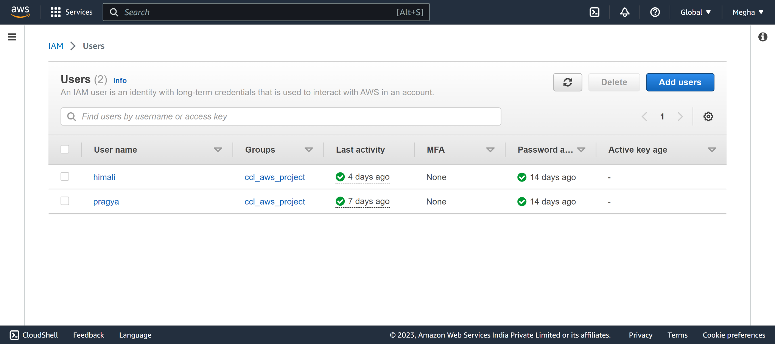
Screenshots:
IAM User creation:

Slide 8
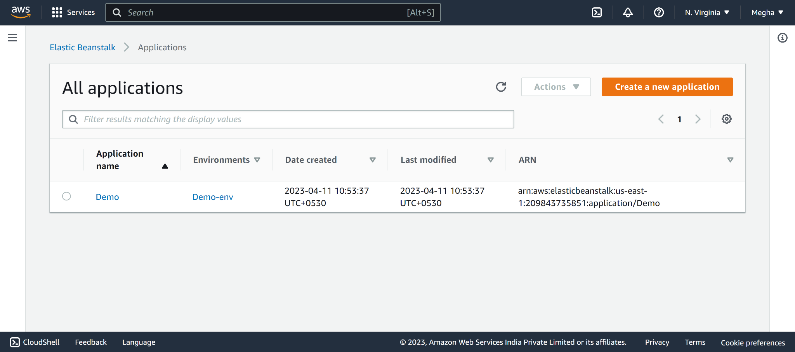
Creating Application on Elastic BeanStalk:

Slide 9
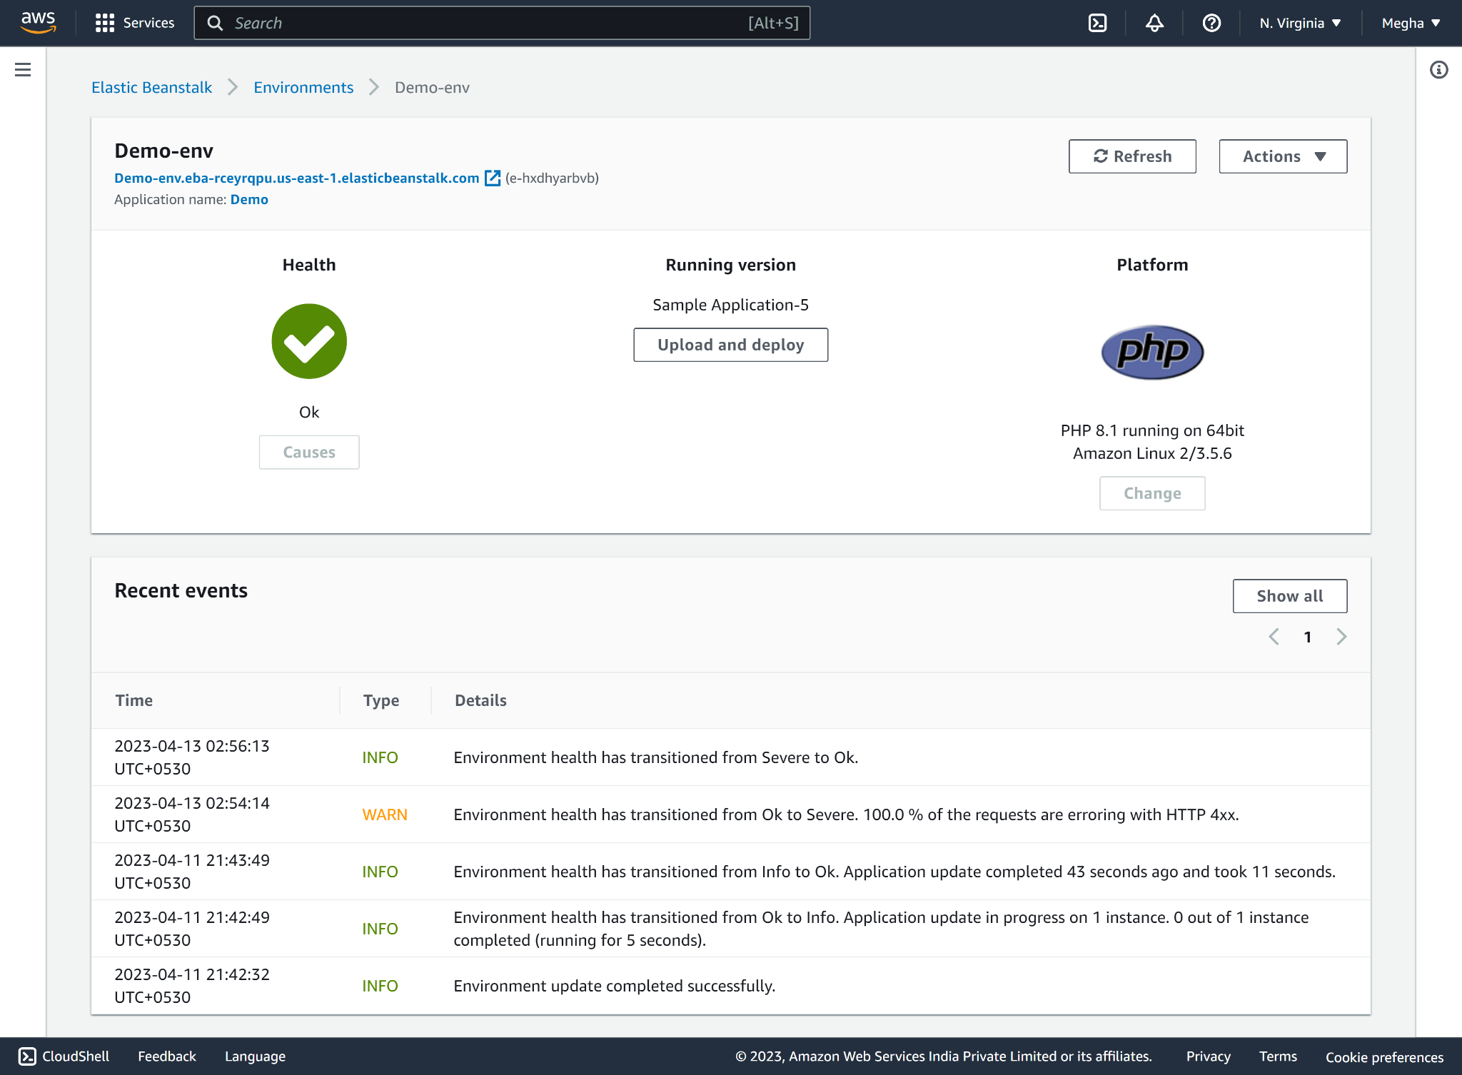
Creating Environment on Elastic BeanStalk:

Slide 10
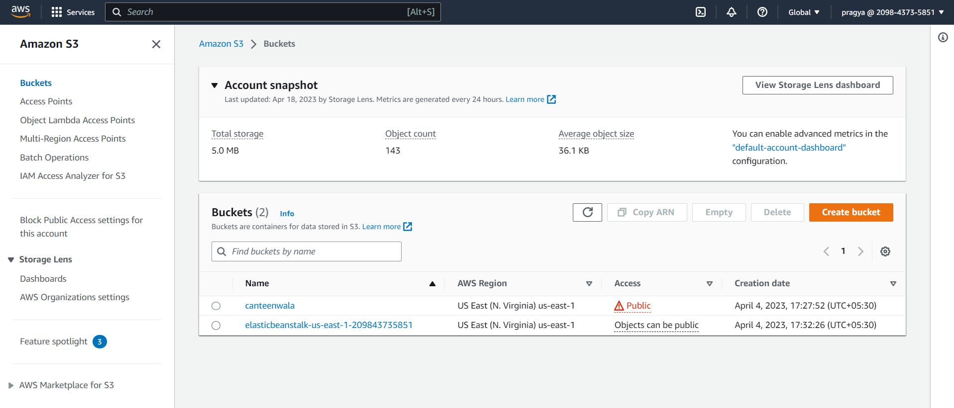
Creating S3 Bucket:

Slide 11
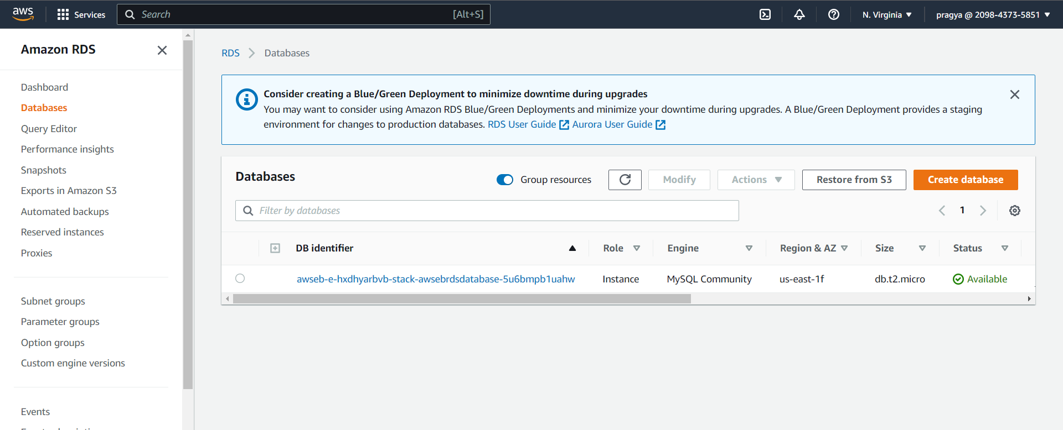
Creating RDS DB Instance:

Slide 12
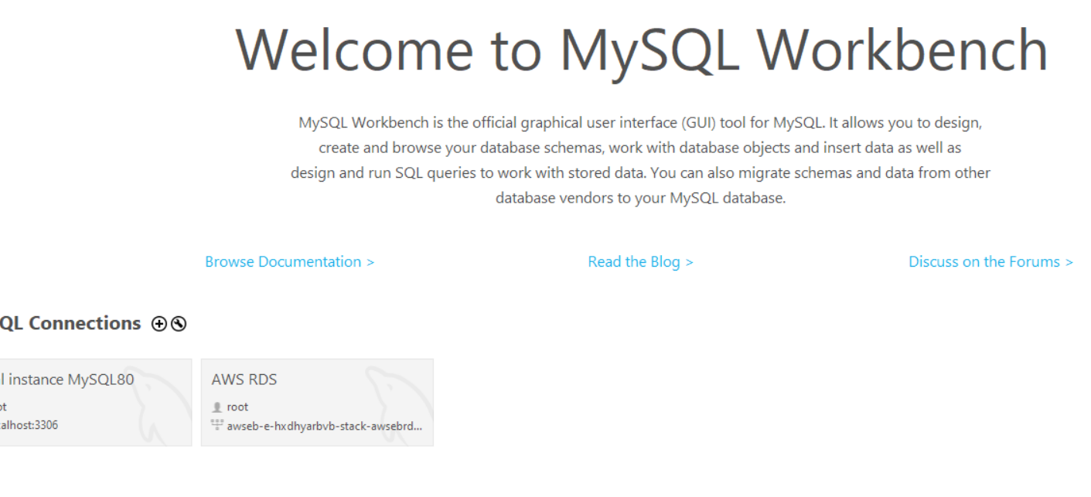
Connecting MySQL workbench with RDS:

Slide 13
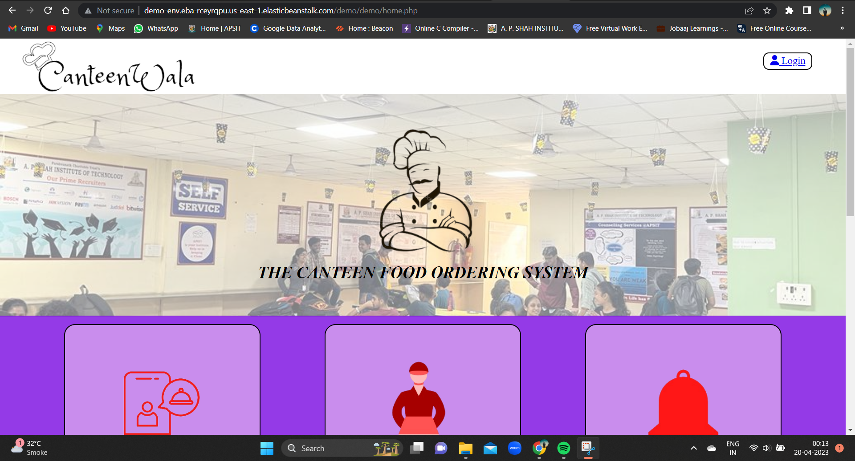
Running the project and getting the output:

Slide 14
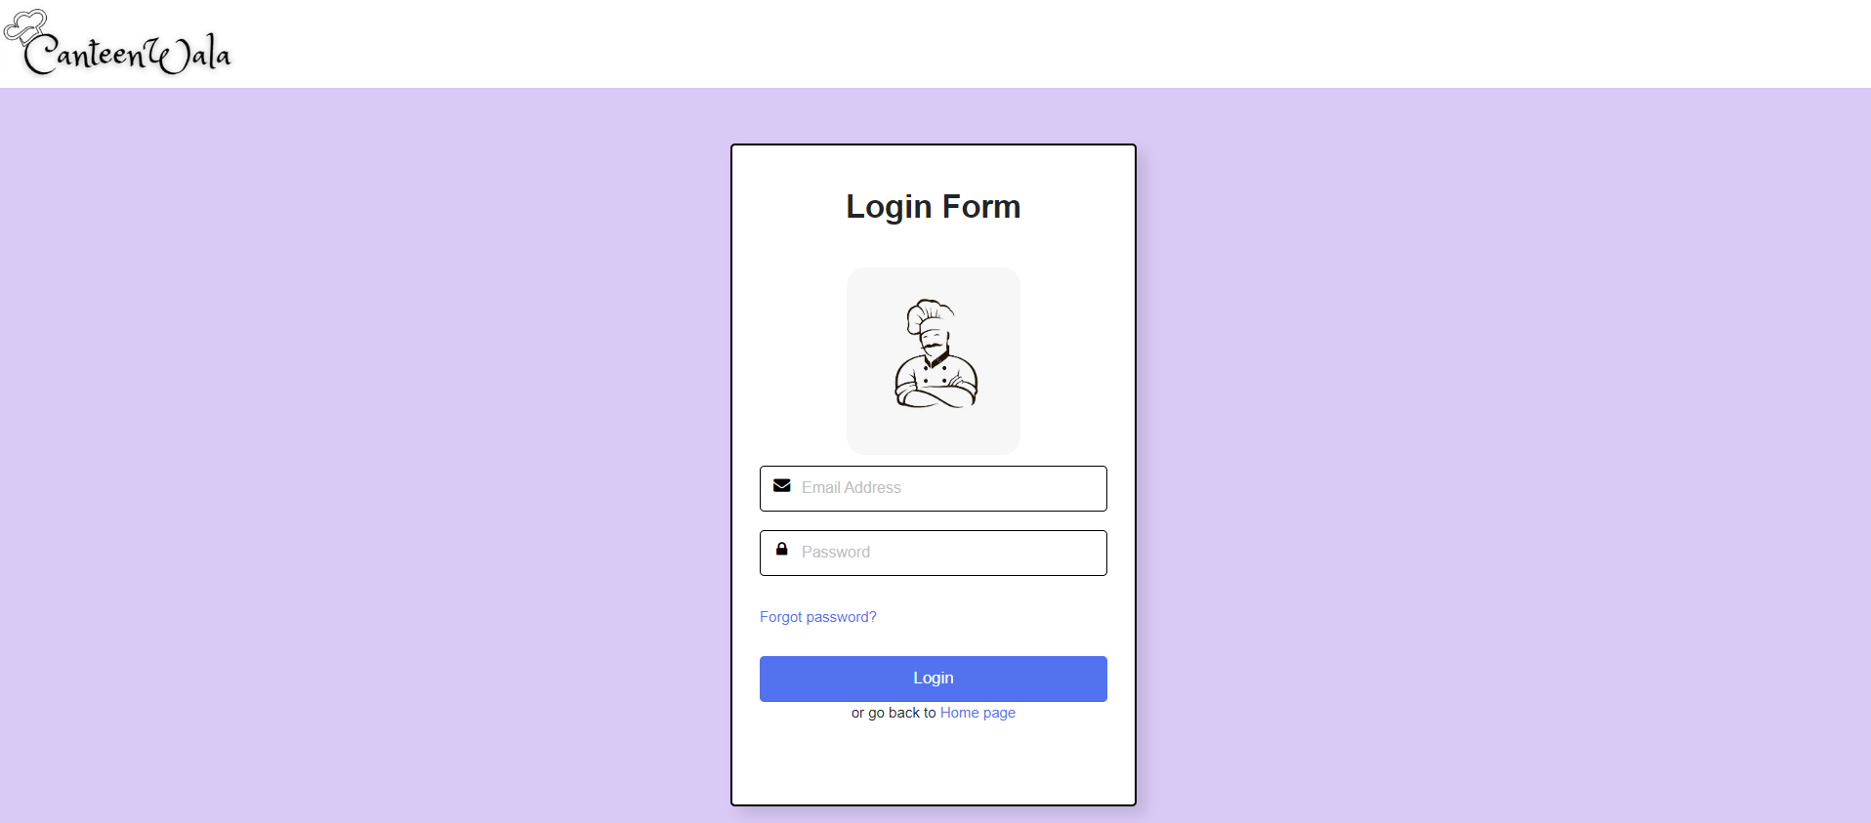

Slide 15
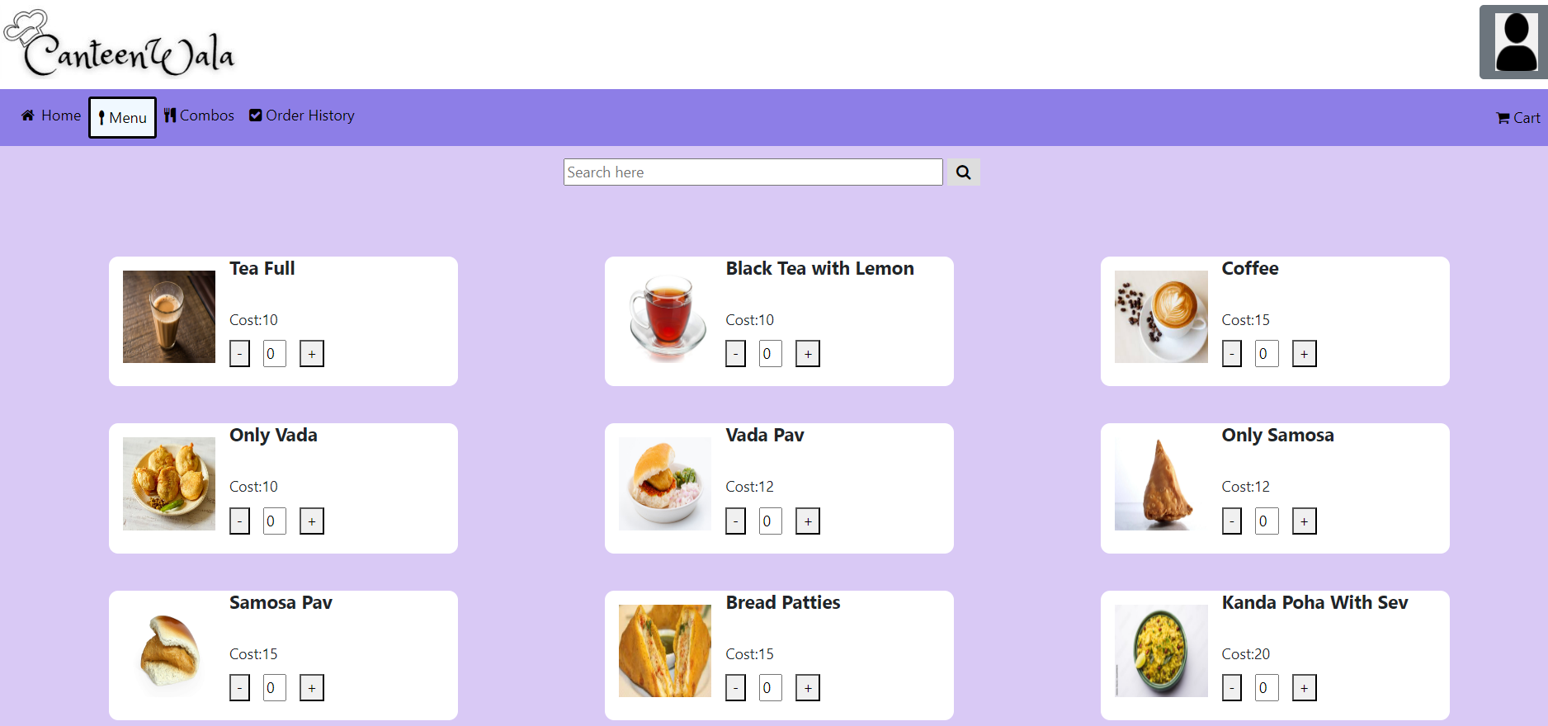

Slide 16
Learning Outcome:
Cloud Computing project "CANTEENWALA" provided valuable knowledge about Cloud-based services.
Learned to use Elastic Beanstalk (EBS) to create applications and environments where EBS generated a functioning application and created connections with RDS.
Learned about S3 buckets to store and retrieve data.
Used RDS to manage databases and imported them into MySQL Workbench.
Learned about IAM for access and permissions management .
Gained practical experience in using different Cloud-based services.
Successfully created and managed the project with cloud computing.

Slide 17

THANKYOU

